Slide 1
Third Covid vaccine approved in the UK
By Michelle Roberts
Health editor, BBC News online
https://www.bbc.com/news/health-55586410

Slide 2
Moderna becomes third Covid vaccine approved in the UK

Slide 4
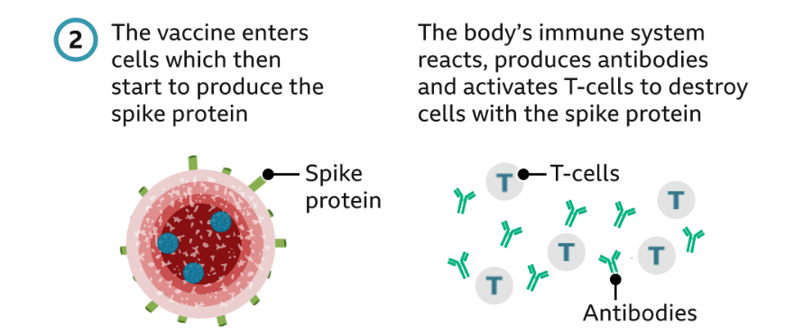

Slide 5
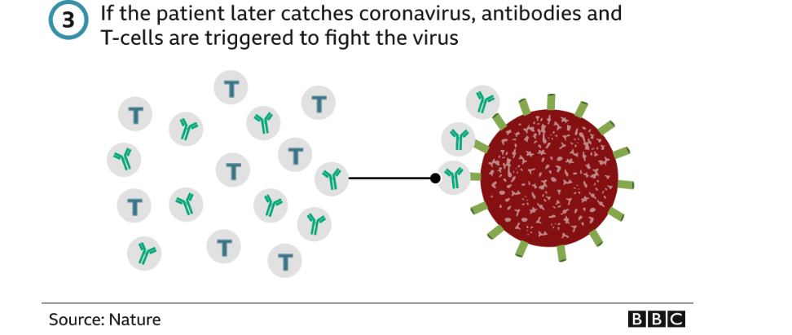

Slide 6
In comparison, the Pfizer/BioNTech one requires temperatures closer to -75C, making transport logistics much more difficult.
The AstraZeneca jab is easier to store and distribute, as it can be kept at normal fridge temperature.
All of these vaccines require a second booster shot, but a first dose is likely to be given to as many people as possible.
In trials with more than 30,000, the Moderna vaccine offered nearly 95% protection from severe Covid.
No vaccine is 100% effective and it takes time for protection to build. For all of the Covid vaccines, we still do not know how long immunity will last.
People who have received a coronavirus vaccine should continue to follow social distancing rules to protect themselves and others.
EU and US regulators have already approved the Moderna vaccine.

Slide 7
